Slide 1


Luiza Souza Simões
—
Validation of remote-control use cases for construction and mining robots via 5G
—
Supervisor: Profa. Dra. Ana Isabela Araújo Cunha
Co-supervisor: M.Sc. Sarah Schmitt
10.07.2023
1
© Fraunhofer IPT/WZL der RWTH Aachen
Notes:
Hey, everyone! Thanks for coming to my presentation. I‘m Luiza as I think you all know, and I have been living here in Germany for a little more than a year now. Working at IPT, I had the opportunity to delve into amazing projects and the 5G.NAMICO, especifically the validation of the remote-contol use cases for construction and mining robots in 5G, was the one chosen for the development of my thesis. I‘d like to extend a special thank you to the evaluation board for being present here and accepting the invitation to participate today, and to my supervisors: Aninha and Sarah, for the support througout this whole journey.
Also I want to thank everyone that could join, thanks for being here, guys… and now, let‘s get started!

Slide 2
Table of Contents
1. | Introduction
2. | Objectives
3. | Contextualization
4. | Measurements Underground Mine Construction Site
5. | Conclusion
10.07.2023
© Fraunhofer IPT/WZL der RWTH Aachen
Notes:
First, this presentation is based on the official document - that I submited as my thesis - and it will follow basically the same structure. We‘ll start with an introduction, so you can understand how we came to the current state of evolution regarding 5G and wireless communication, and then I‘ll talk a little bit about what is the 5G.NAMICO project about.

Slide 3
Table of Contents
1. | Introduction
2. | Objectives
3. | Contextualization
4. | Measurements Underground Mine Construction Site
5. | Conclusion
10.07.2023
© Fraunhofer IPT/WZL der RWTH Aachen
Notes:
After that, we have the objectives, so what was programmed for this research and what we can expect from it.

Slide 4
Table of Contents
1. | Introduction
2. | Objectives
3. | Contextualization
4. | Measurements Underground Mine Construction Site
5. | Conclusion
10.07.2023
© Fraunhofer IPT/WZL der RWTH Aachen
Notes:
Then I‘ll provide a little bit of context and explain important concepts, so everyone can understand and follow what I‘m saying.

Slide 5
Table of Contents
1. | Introduction
2. | Objectives
3. | Contextualization
4. | Measurements Underground Mine Construction Site
5. | Conclusion
10.07.2023
© Fraunhofer IPT/WZL der RWTH Aachen
Notes:
Most importantly, we come to the measurement section. Here I‘ll let you know what was done, which kind of tests, measurements, results and all of the analysis we performed.

Slide 6
Table of Contents
1. | Introduction
2. | Objectives
3. | Contextualization
4. | Measurements Underground Mine Construction Site
5. | Conclusion
10.07.2023
© Fraunhofer IPT/WZL der RWTH Aachen
Notes:
By the end, I‘ll wrap everything up, present the conclusion of this work, and bring the following steps for further studies.

Slide 7
Table of Contents
1. | Introduction
2. | Objectives
3. | Contextualization
4. | Measurements Underground Mine Construction Site
5. | Conclusion
10.07.2023
© Fraunhofer IPT/WZL der RWTH Aachen
Notes:
Well, I gave you a ton of information now, but let‘s start slow, step by step, from the beginning. I‘ll tell you a little bit about how we came to the technology we have today, how 5G evolved and how does it all relate to the NAMICO project.

Slide 8
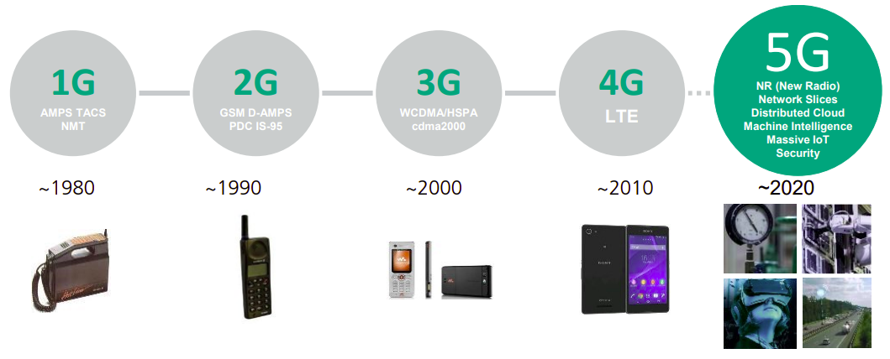
The Evolution of Wireless Connectivity
From 1G to 5G
Evolution of wireless communication [Image]. In: 5G – Capabilities and potentials. Fraunhofer IPT. Accessed on June 21, 2023.
10.07.2023
© Fraunhofer IPT/WZL der RWTH Aachen
Notes:
Ok, it all started around the 70~80s [CLICK], due to a demand for faster communication in the world. We began with 1G, the first generation.
It was actually very basic, only for mobile telephony and phone calls, security was not a high priority.
Then came 2G [CLICK], improving the phones with text messages and SMS, besides enabling calls outside the geographic coverage area – which is the roaming as we know.
In 3G [CLICK], the telephones started to shrink in size, and came the possibily to web browse. The internet started to gain popularity and the industry was pushed to evolve to the next generation, 4G [CLICK].
Here, the possibility of video consumption arose along with way higher data speeds.
Finally, [CLICK] 5G brought the digitization of the industry and the development of the IoT, which is the Internet of Things. It brings a faster and safer network that allows communication between billions of devices, making the ideal parameters available for each use case that we'll see.

Slide 9

The Evolution of Wireless Connectivity
The 5G.NAMICO project
The 5G.NAMICO project logo [Image]. In: RWTH Aachen University. Available at: https://5g.namico.rwth-aachen.de. Accessed on June 21, 2023.
10.07.2023
© Fraunhofer IPT/WZL der RWTH Aachen
Notes:
So it‘s because of this kind of flexibility that 5G becomes ideal for application and was chosen in the 5G.NAMICO project. The Network, Adaptive Mining and Construction project was funded by the North Rhine-Westphalia, which is the biggest state of Germany, and has the responsability to develop a 5G connection on a construction site and in an underground mine.

Slide 10
Table of Contents
1. | Introduction
2. | Objectives
3. | Contextualization
4. | Measurements Underground Mine Construction Site
5. | Conclusion
10.07.2023
© Fraunhofer IPT/WZL der RWTH Aachen
Notes:
Moving on, I want to make the objectives of this work clear for everyone.

Slide 11
Definition of the Study Problem
Key objectives
Conduct a bibliographic review of existing works on the subject.
Write a detailed description of the Use Cases and Network Setup.
Create and plan a setup for 5G applications in the Construction and Mining sections.
Set up a test plan to assess the 5G network performance and suitability (measurement methods).
Validate the work and data extracted in different scenarios
10.07.2023
© Fraunhofer IPT/WZL der RWTH Aachen
Notes:
Well, [CLICK] to begin with, the primary objective of this study was to conduct an extensive literature review of existing works in the field. This phase enhanced a lot my understanding and provided a solid foundation for the topic I aimed to address and write about.
[CLICK] Following that, it became important to document the use cases, along with outlining the planned network setup for implementation in various scenarios. This step represented the ultimate goal of the entire project.
[CLICK] After, it was necessary to devise a comprehensive plan and strategize the most effective methods for measuring the applications in the domains of Construction and Mining.
[CLICK] Then, a test plan was established to acquire valuable insights and determine the specific parameters to be extracted from the scenarios, as well as the anticipated values to be obtained.
[CLICK] At the end of it all, it was fundamental to validate the data collected and compare it against the expected results. This process allowed a thorough analysis of the functionality, areas for improvement, and the current state of each application.

Slide 12
Table of Contents
1. | Introduction
2. | Objectives
3. | Contextualization
4. | Measurements Underground Mine Construction Site
5. | Conclusion
10.07.2023
© Fraunhofer IPT/WZL der RWTH Aachen
Notes:
Ok, so let‘s dive into the contextualization so I can explain everything you need to know to understand this presentation.

Slide 13
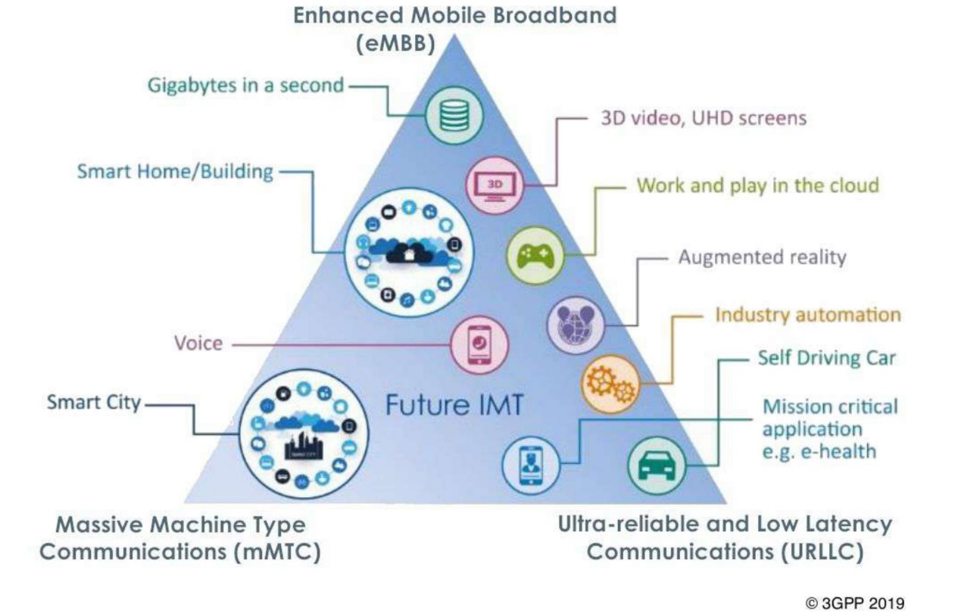
Contextualization
Important concepts
1
uRLLC
Ultra-Reliable Low Latency Communication
2
eMBB
Enhanced Mobile Broadband
3
mMTC
Massive Machine Type Communication
5G features and its applications [Image]. In: 3GPP. Available at: https://fuenf-g.de/2019/09/26/die-schrittmacher-von-5g/##. Accessed on June 22, 2023.
10.07.2023
© Fraunhofer IPT/WZL der RWTH Aachen
Notes:
The architecture of 5G is designed based on three main features: [CLICK] Ultra-Reliable Low Latency Communication, [CLICK] Enhanced Mobile Broadband, [CLICK] and Massive Machine Type Communication. Each feature contributes for providing a nice performance of different applications and use cases, which are stated [CLICK] here in the picture, so each one of those use cases stand closer to the characteristics that are most important to them.
uRLLC is requested on time-critical applications because it guarantees minimal latency times, so it makes communication fast.
eMBB defines a minimum level of data transfer, so it can take up incresed bandwidth along with decreased latency. It enables application like 8K video streaming and Augmented and Virtual Reality.
mMTC supports connection between several devices, up to a million even, with really high eficiency for mobile devices. This way, sensors, machines, robots and devices can freely comunicate and exchange data among them. So that‘s why the Smart Cities is the use case that relies the most on this feature and it‘s here right at the bottom left tip of the triangle.
Besides those is also the network slicing characteristic which refers to partitioning the physical network into several virtual networks. This means we can configure and adjust sections of the network to the necessity of each use case, enabling the possibility to regulate each of these three features I described.

Slide 14
Contextualization
Use Cases
Real-time condition monitoring
Health and safety at worksites
Autonomous machinery
Collect information
Basis for decision-making
Improve efficiency
Higher productivity and sustainability
Safer work environments
Accident prevention
Reduce unplanned
maintainance
Progress monitoring
“In 1995–2005, up to 90% of fatal mining accidents were equipment related, while maintenance is responsible for 41% of a mine’s equipment costs. […] Studies say 70% of machine-specific malfunctions could be prevented by collecting and analyzing the machine's data.”
- ERICSSON. Connected Mining: A Guide to smart mining transformation with private cellular technology. 2020
10.07.2023
© Fraunhofer IPT/WZL der RWTH Aachen
Notes:
Now, when it comes to the construction site and mining scenario, all of these applications converge to define various use cases planned for implementation on the sites.
Three notable ones include real-time monitoring, health and safety at worksites, and autonomous machinery. Each of these use cases adopts a unique strategy to enhance the work environment, with all of them relying on the utilization of sensors.
The first use case involves the collection of information from the site, such as video, images, and physical parameters that can impact the decision-making process on the worksite. Armed with this kind data, a control center, overseen by an operator, can provide vital information and prevent workers from being directly exposed to potentially dangerous situations.
The second use case focuses on identifying high-risk areas within the worksite and tracking the position of workers and machinery in real-time. The objective in this one is to closely monitor these elements and promptly send notifications when necessary. We all know that accidents can often happen in this kind of work environment, and a study showed that “70% of machine-specific malfunctions could be prevented by collecting and analyzing the machine's data”. With that said, this proactive approach aims to prevent those accidents and save lives by effectively reducing the occurrence of accidents.
Last but not least is autonomous machinery. This particular application’s goal is to use real-time sensors to organize tasks and improve the efficiency of processes that have an impact on the final outcome. It counts with various functionalities such as drone monitoring, inspections, and mapping, all of which contribute to the generation of more accurate and cost-efficient plans, optimizing operations, achieving higher productivity levels, and therefore leading to better results.

Slide 15
Table of Contents
1. | Introduction
2. | Objectives
3. | Contextualization
4. | Measurements Underground Mine Construction Site
5. | Conclusion
10.07.2023
© Fraunhofer IPT/WZL der RWTH Aachen
Notes:
Ok, hope everyone is following. Let‘s then begin with the measurements.

Slide 16
Measurements
Expected results
Expected Latency and Data Rate Requirements.
Device |  | Latency Requirement |  | Expected Data Rate
Remote Monitoring |  | < 10 ms |  | DL ≥ 1 Mbps UL ≥ 1 Mbps
Remote Control |  | < 10 ms |  | DL ≥ 1 Mbps UL ≥ 1 Mbps
2D-LIDAR |  | < 20 ms |  | DL ≥ 1 Mbps UL ≥ 1 Mbps
3D-LIDAR |  | < 50 ms |  | DL ≥ 1 Mbps (Ouster) UL ≥ 300 Mbps (Leica) UL ≥ 500 Mbps
Radar |  | 200 ms |  | DL ≥ 1 Mbps UL ≥ 100 Mbps
Cameras |  | < 10 ms |  | DL ≥ 1 Mbps UL : 8 - 48 Mbps
Voice over IP |  | 20 – 100 ms |  | DL: 5 − 25 Mbps UL: 5 − 25 Mbps
10.07.2023
© Fraunhofer IPT/WZL der RWTH Aachen
Notes:
But first I would like to show this table, which consists of the expected results for each device or equipment to work correctly within the use cases. We can see that it is important that communication is fast, since we have three items operating with latencies below ten seconds. So packets traveling from one point to another in a network in less than ten seconds.
And for most use cases, unlike what we first might think, most devices don‘t require huge data rates. We can see all those [POINT] converging for at least 1 Mbps in download and upload, and only the ones that deal with video imaging and voice require some higher values. At the end of it, we WILL require a higher data rate because of those so all of them can operate simultaneously.

Slide 17
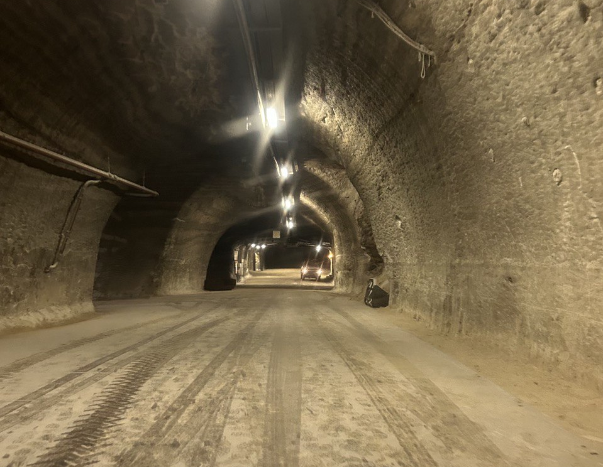
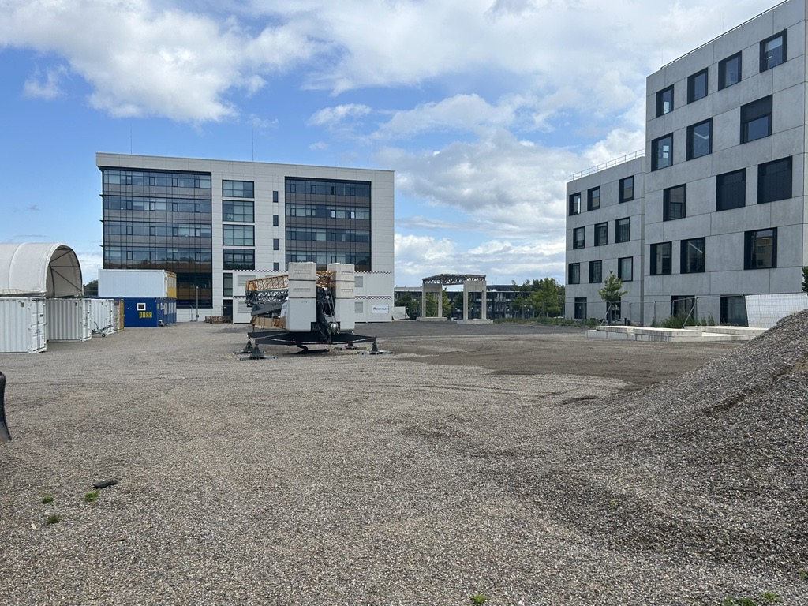
Measurements
The scenarios
The Underground Mine
The Construction Site
10.07.2023
© Fraunhofer IPT/WZL der RWTH Aachen
Notes:
In this slide I just wanted you to have a quick view of the scenarios. This on the left is inside the mine, and on the right is the Construction Site.

Slide 18
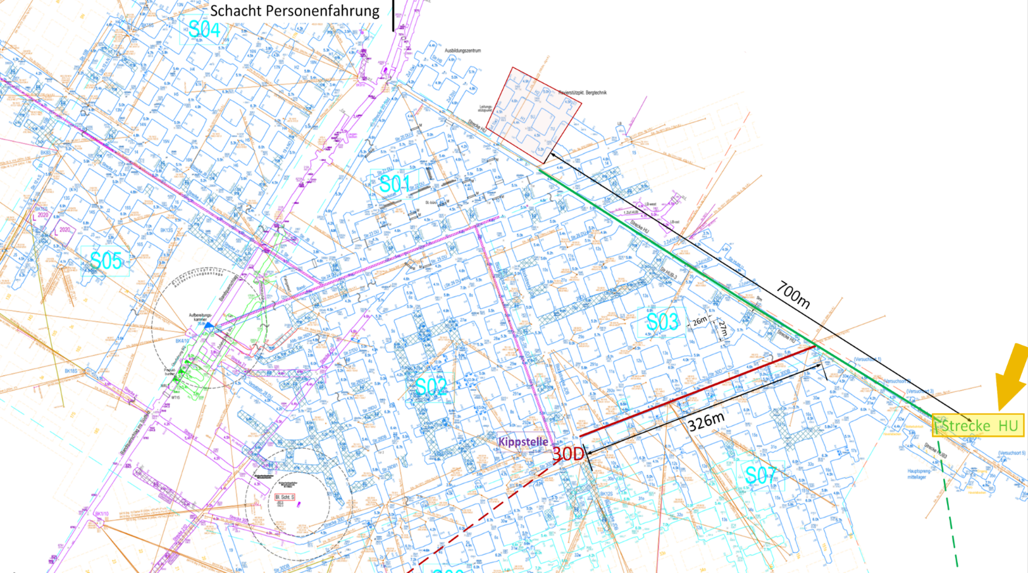
Measurements
Underground Mine
Characteristics:
Approximately 700 meters below surface
Wi-Fi setup
Test parameters:
Latency
Throughput
Signal quality
Coverage
[1]
10.07.2023
© Fraunhofer IPT/WZL der RWTH Aachen
Notes:
The first measurements that were performed were in the Underground Mine. In this scenario, the goal is to stablish a communication that can facilitate the work inside the mine.
It is located approximately 700 meters below the surface and, at the time we were able to visit, the 5G network was not yet installed, so the tests were performed with the WiFi network available. The parameters we used for the measurements were: latency, throughput, signal quality and coverage.
We measured the network throughout this tunnel here [SHOW], starting right from this point.

Slide 19
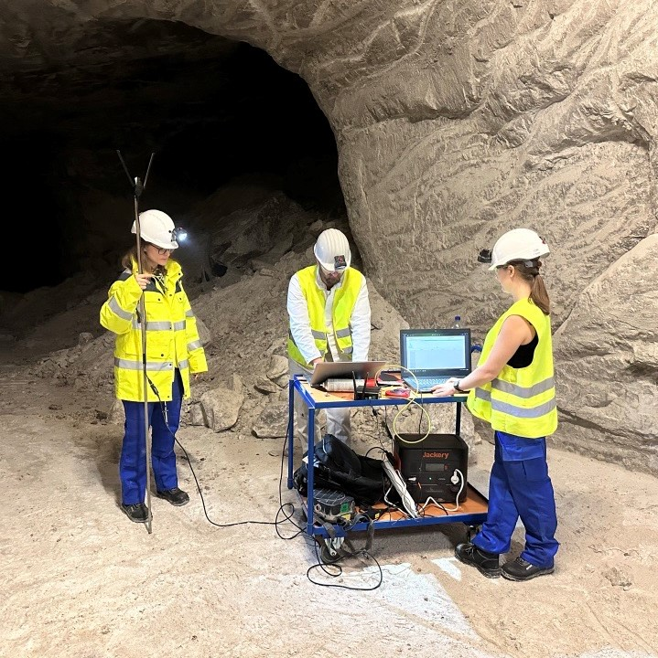
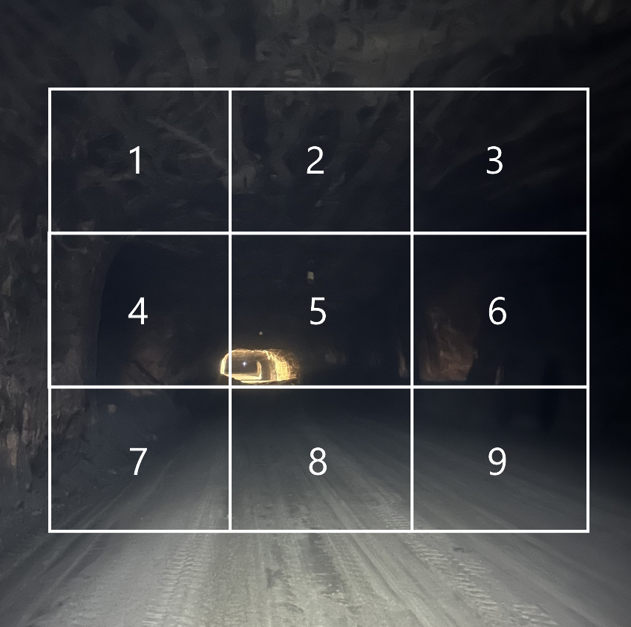
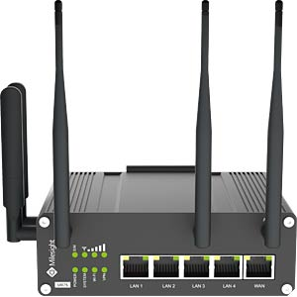
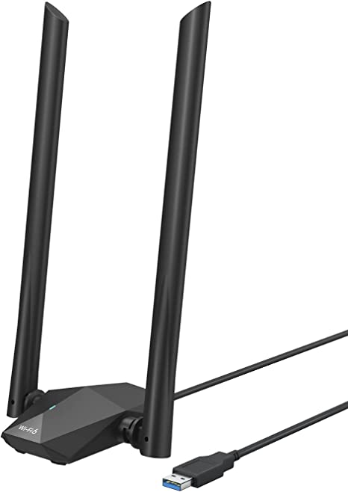
Measurements
Underground Mine
[2]
[3]
10.07.2023
© Fraunhofer IPT/WZL der RWTH Aachen
Notes:
On the right side here are the devices we used. The first one is the Milesight Router, which is an industrial router, and the second is the BrosTrend device, which is a regular router. The photo in the middle is a description of how we measured the network. So considering a cross section of the tunnel like the one in this picture, we divided it into 9 areas, and for every hundred meters, we performed the tests in all of those areas, until we lost coverage. The milesight is a heavier device, so it only operated in the lower row (so 7, 8 and 9), but the BrosTrend device was lighter so we were able to attach it to a metal stick that allowed it to go higher.
This first photo here is the measuring teams.

Slide 20
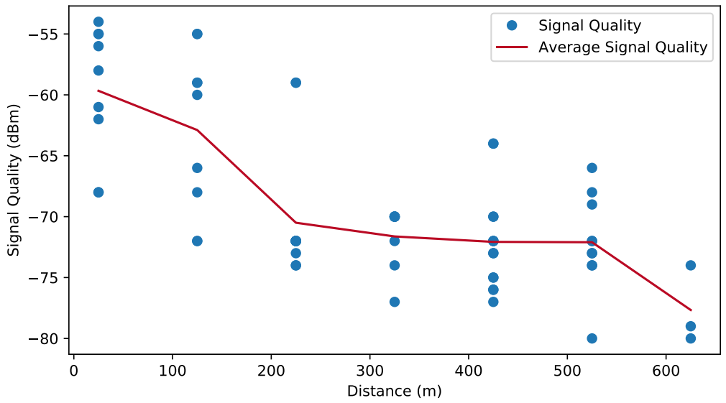
Measurements
Underground Mine
Signal Quality x Distance for BrosTrend device
10.07.2023
© Fraunhofer IPT/WZL der RWTH Aachen
Notes:
Here we can see the first results from the signal quality measurements. The dots represent each measurement alone and the line is the average between the dots, according to the distance. It‘s also possible to see that the signal quality decreases as we would stand further from the central WiFi router, which is expected, right? Usually, and as we see here in this case, the signal is stronger near the router, so as we moved away from it, it is normal that it‘s quality drops until is unreachable.

Slide 21
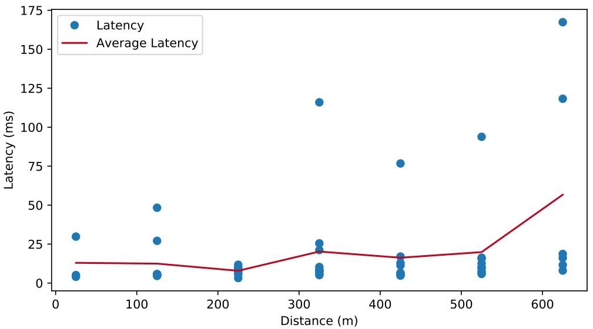
Measurements
Underground Mine
Latency x Distance for BrosTrend device
10.07.2023
© Fraunhofer IPT/WZL der RWTH Aachen
Notes:
The same happens for the latency, and we can even relate this behavior with the impact that signal quality has on it. Although it starts with a nice, almost constant line for the first 200 meters, we can see a rise starting in the middle of the path that increases by the end. We can also see that it starts near 15 ms and it ends a little bit over 50. With these measurements, even at it’s best, most of the use cases would not be able to fully operate, since they require a faster communication as we saw on the previous Table.

Slide 22
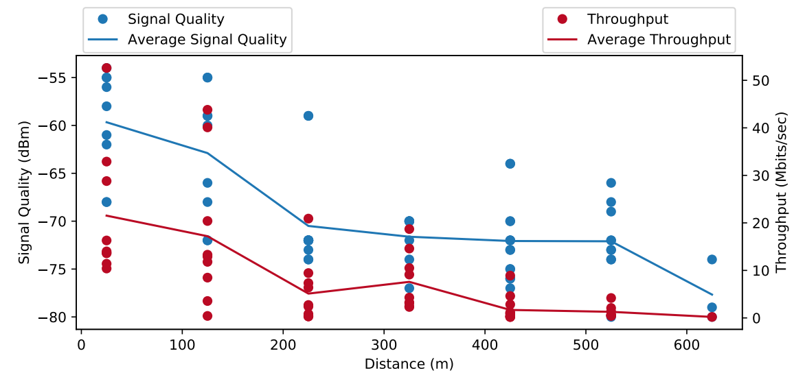
Measurements
Underground Mine
Signal Quality and Throughput x Distance for BrosTrend device
10.07.2023
© Fraunhofer IPT/WZL der RWTH Aachen
Notes:
We also have the graphical influence of the signal quality on throughput in this other chart. Here, we have the values for the signal quality in the axis on the left, while the measurements for the throughput are marked in the axis on the right.
We can see a similar behavior being better at start and worsening with the distance. Throughput starts at around 20 Mbits/sec until it drops to no data rate. In the beginning, the network showed nice results, but it would not be sufficient to cover the applications that required 3D devices. Also, when working simultaneously, the network might not respond so well to the high demand that the devices would request.

Slide 23
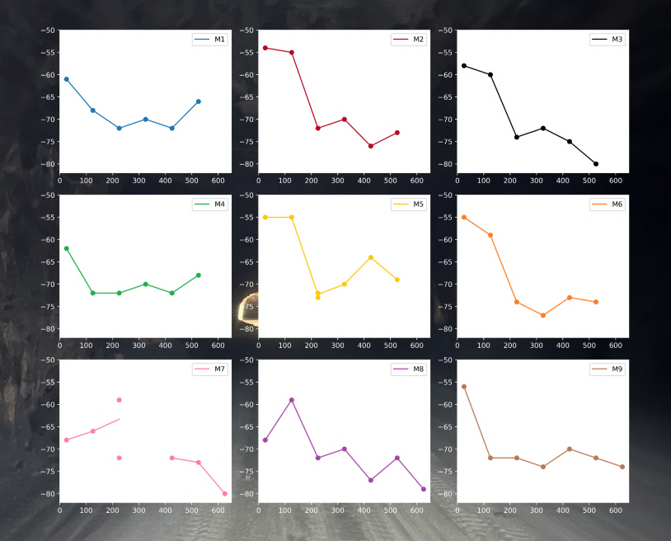
Measurements
Signal Quality x Distance
Underground Mine
What do these results mean?
Signal quality x distance
Most consistent: M1 and M4
Best connectivity: average -64,83 dBm (M5)
Distribution reason might be:
Location of the server
Geometry of the walls
Physical barriers and metallic structures
Penetration loss, multi-path fading
Latency requirement X
Throughput requirement X
10.07.2023
© Fraunhofer IPT/WZL der RWTH Aachen
Notes:
Ok, so what else can we get from these results? Here on the right, I organized the measurements according to the area where they were taken. We can see that the measurements from the areas 1 and 4 were the most consistent ones, while the one that maintain a higher average value… let me zoom in a little bit so you can follow…

Slide 24
Measurements
Signal Quality x Distance
Underground Mine
What do these results mean?
Signal quality x distance
Most consistent: M1 and M4
Best connectivity: average -64,83 dBm (M5)
Distribution reason might be:
Location of the server
Geometry of the walls
Physical barriers and metallic structures
Penetration loss, multi-path fading
Latency requirement X
Throughput requirement X
10.07.2023
© Fraunhofer IPT/WZL der RWTH Aachen
Notes:
was the measurement from area 5. It displayed an average of -64,83 dBm, although it presented a quite unstable output as you can see.

Slide 25
Measurements
Signal Quality x Distance
Underground Mine
What do these results mean?
Signal quality x distance
Most consistent: M1 and M4
Best connectivity: average -64,83 dBm (M5)
Distribution reason might be:
Location of the server
Geometry of the walls
Physical barriers and metallic structures
Penetration loss, multi-path fading
Latency requirement X
Throughput requirement X
10.07.2023
© Fraunhofer IPT/WZL der RWTH Aachen
Notes:
The reason these areas show different results might be related to the location of the server, as it could benefit one location more than the other, the geometry of the walls, physical barriers, metals that might contain or reflect the signal that is being propagated… and even penetration loss and multi-path fading, which we know can happen in those kind of environments that present different types of material and structures.
All in all, even though there are slight variations in signal quality across the different areas of the tunnel’s cross-section, the changes observed here remain relatively insignificant, as they consistently hover in a range of approximately plus or minus 10 dBm from the average value for all of them.
With the results we got, it is proven that WiFi would not be able to sustain the applications, neither for latency nor for throughput, as I mentioned before.

Slide 26
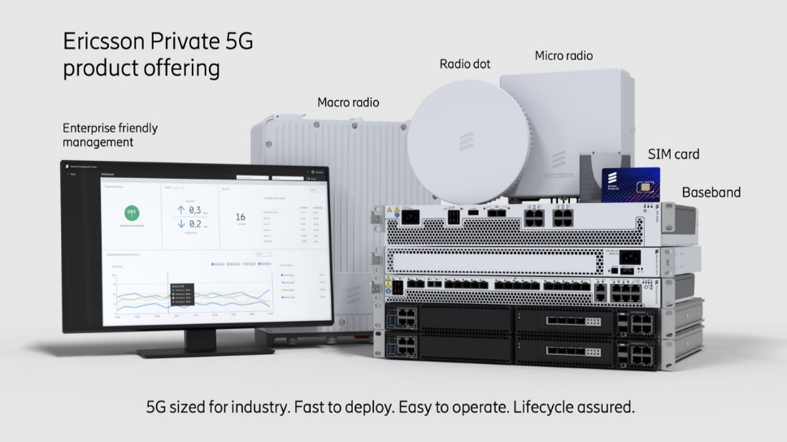
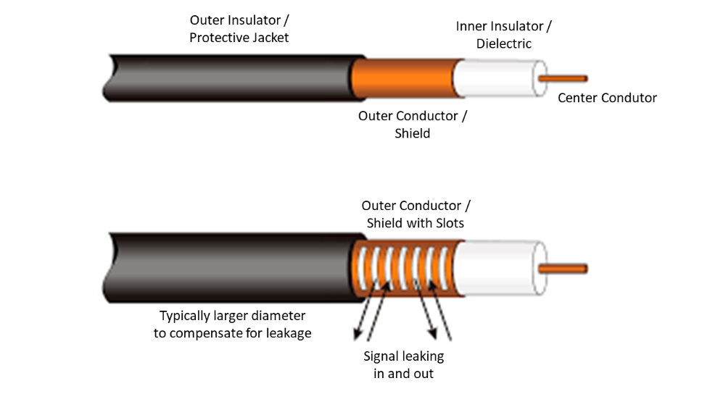
Measurements
Underground Mine
How will these results be enhanced?
Installation of 5G
Efficient architecture
Reliable network
Leaky Feeder cables
Similar to an antenna
Improve propagation
Better signal quality
Consistent network
Penetration loss, multi-path fading
[4]
[5]
10.07.2023
© Fraunhofer IPT/WZL der RWTH Aachen
Notes:
But now, how will these results be enhanced?
First, there will be the installation of the 5G system, which comes with a more efficient architecture, providing a more consistent, stable and reliable network. This alone should already upgrade the results, but besides that, there will also be the installation of Leaky Feeder cables.
These cables are designed to radiate - or “leak”, hence the name - a portion of its signal along its length, and it’s commonly used in underground spaces to provide reliable wireless communication coverage, which is exactly what we wanna get. The cable has small slots in its outer conductor, that allow the signals to escape and propagate throughout the surroundings. It kind of works like a long antenna.
Well, understanding what they are for, it becomes clear that these cables will provide a very good impact not only on the propagation of the signal, but also on its quality, on the consistency and reliability of the network and on the loss and fading rates.

Slide 27
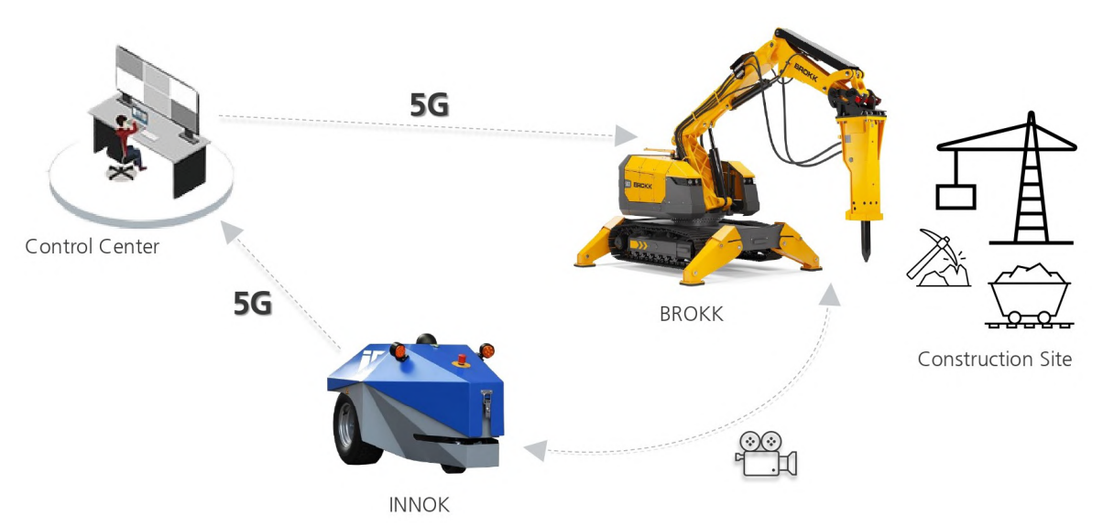
Measurements
Construction Site
Characteristics:
Autonomous Machinery use case
uRLLC, eMBB, and mMTC
Task and safety monitoring
5G setup
Test parameters:
Latency
Throughput
Signal quality
Coverage
[6]
10.07.2023
© Fraunhofer IPT/WZL der RWTH Aachen
Notes:
Now delving into the Construction Site measurements, let me explain a bit of how 5G should impact the worksite.
First, the use case in use for this will be the autonomous machinery use case. It will require a combination of the characteristics that I explained to gather information from the site and send them to an operator. Here in the photo, you can see very clearly. The INNOK machine will approach the working area as it collects video data from it and sends it to the control center. There, the operator will be able to safely send commands to the other machine, the BROKK. This cycle will enable a much safer task monitoring.
For the measurements, there was a 5G setup available, and the test parameters were the same as the ones used for the Mine.

Slide 28
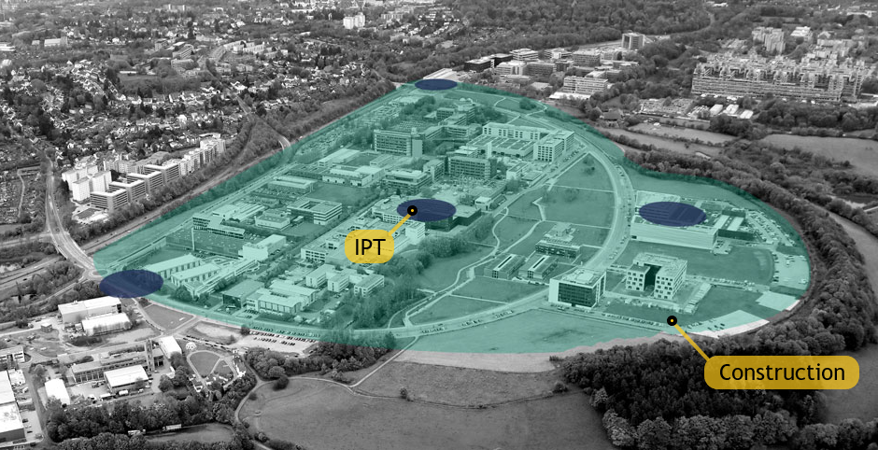
Measurements
Construction Site
5G in Campus Melaten
5G Antennas in dark blue
Outside network
Distance: ~300m
Coverage in turquoise
Omni-antenna installation
Fiber cables
[7]
10.07.2023
© Fraunhofer IPT/WZL der RWTH Aachen
Notes:
Although we were able to test with 5G at the Construction Site, like for the Mine it was done a pre investigation of the scenario. This is because the setup was acquired not from the complete installation of 5G, but from the previous setup in the Site. Since the 5G network used will be the one provided from the Fraunhofer IPT, before the complete installation of the Construction Site’s omni-antennas and the fiber cables, the measurements were done with the coverage acquired from the antenna that is located at IPT so we can compare the results as the project will advance.
In the picture you can see the antennas in dark blue, and the coverage in light blue. The distance between this antenna and the site is of approximately 300 meters.

Slide 29
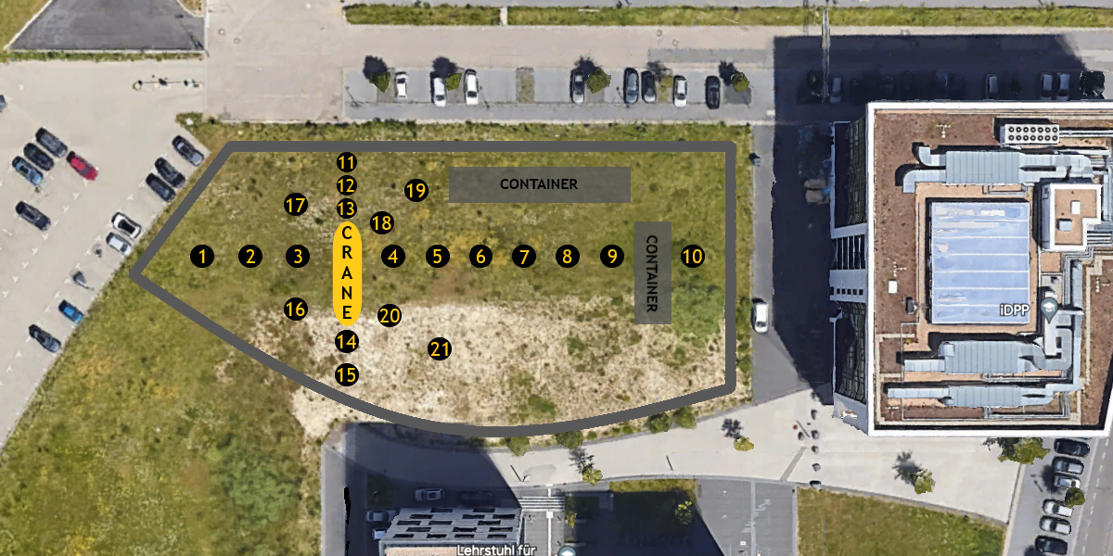
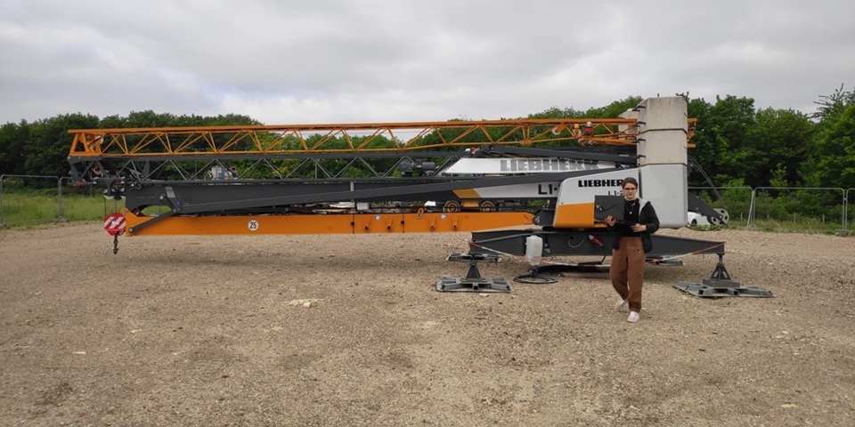
Measurements
Construction Site
Latency and throughput
Ping and iperf3 tests
WNC and Quectel setup
Two different ping tests (network controller and device)
[8]
10.07.2023
© Fraunhofer IPT/WZL der RWTH Aachen
Notes:
Ok! So here we have the ground where the Construction is located. This photo was taken with the help of Google Earth, and the other one in the right is the actual location with the crane in the middle.
The numbered points in the large photo are the measurement points. We tried to evaluate the influence of the machinery on the results by getting points that are close to the crane and moving away from it. In each of those points, two ping tests were performed, along with one iperf3 test. These test are set to acquire latency and throughput values, and here is how they were done.

Slide 30
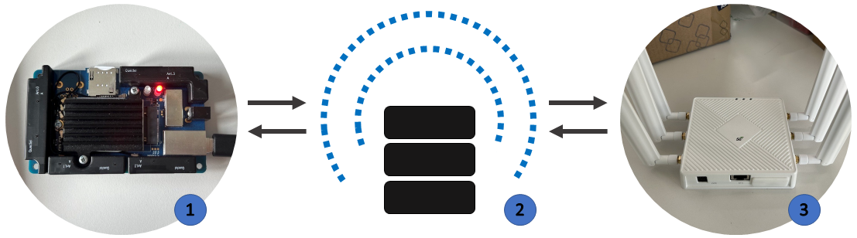
Measurements
Construction Site
Latency and throughput
Ping and iperf3 tests
WNC and Quectel setup
Two different ping tests (network controller and device)
Quectel
Network Controller
WNC
10.07.2023
© Fraunhofer IPT/WZL der RWTH Aachen
Notes:
The first ping test was performed D2D, I mean device to device. We connected a Quectel Module and a WNC router to the 5G network and did a ping between them. This provided the round-trip time for a packet to travel from one device.. to the other.. back to the first device. But for that, the packet had to be sent through the network controller as a mediator, which elongates the route a little.
Because of that, we also tried a ping between the Quectel and the network controller, removing step number three over there.
We will be able to compare both results in the following slides.
It’s important to state that the network controller was located at IPT, so the results will show a higher response than when the setup is complete, because of the distance.
As for the iperf3 test, it can be set with a server and a client. We used the WNC as server and set the Quectel as the client. This way, both devices could exchange data and provide the throughput results.

Slide 31

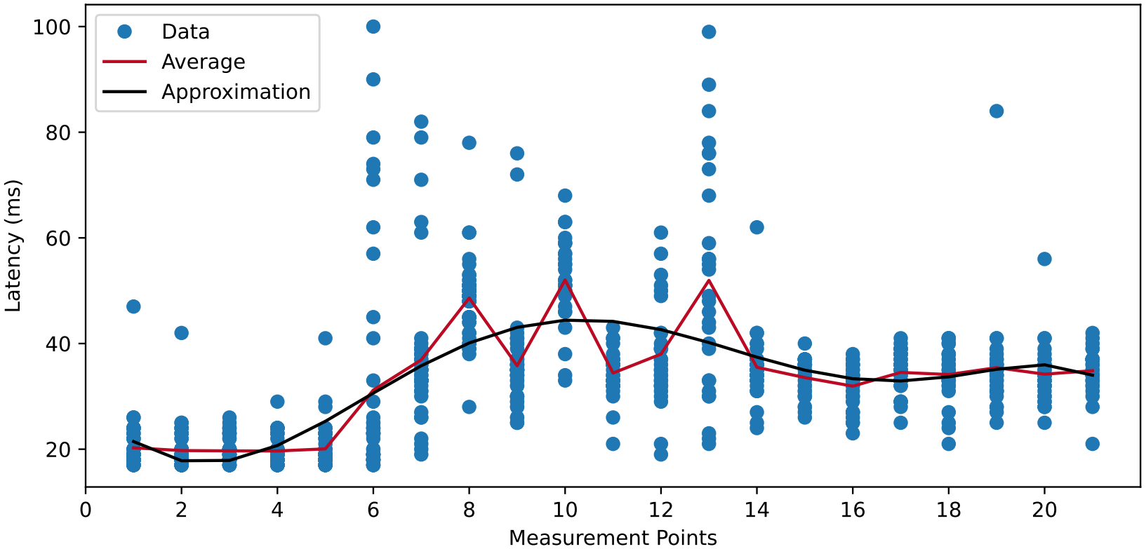
Measurements
Construction Site
Latency x Measurement points for Quectel → WNC
10.07.2023
© Fraunhofer IPT/WZL der RWTH Aachen
Notes:
Ok, so for the first ping test, Quectel to WNC, the chart shows the measurements in blue, the average in red and a polynomial approximation in black. We can see that it begins around 20ms, and it starts rising when it gets to point number 4. [SHOW] After that, it only goes up until point number 10, when the graph gets to 40ms, takes a turn and starts to decrease. This might indicate some influence of the buildings around the location, since latency shows a worst result as it gets nearer to the containers and the building on the right. If you can see here, the chart only normalizes after the measurement points returned to be closer to the crane.

Slide 32
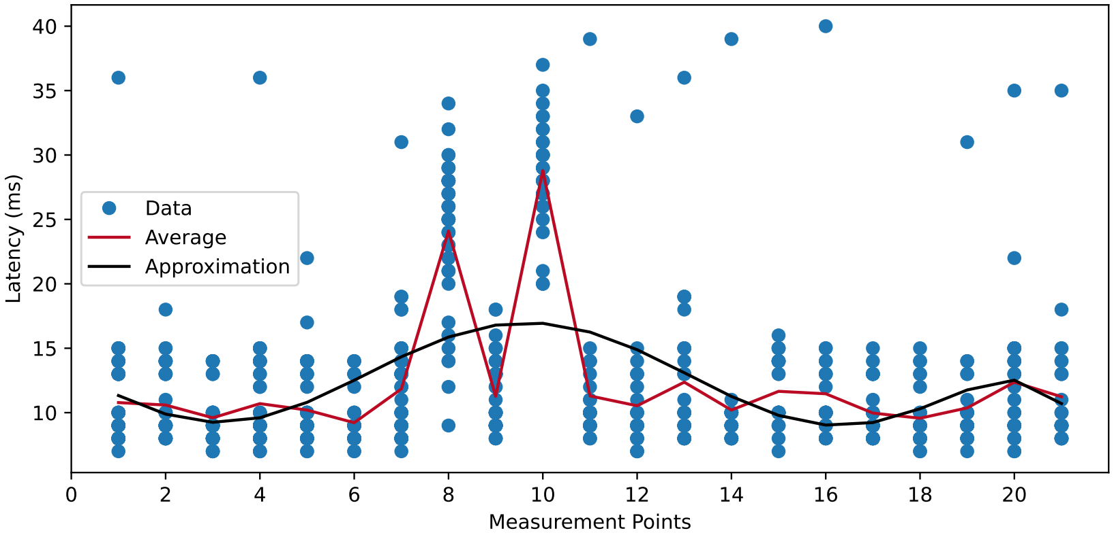
Measurements
Construction Site
Latency x Measurement points for Quectel → Network Controller
10.07.2023
© Fraunhofer IPT/WZL der RWTH Aachen
Notes:
The same behavior can be seen in this second chart. This one is related to the ping test between Quectel and Network controller, and as we predicted, the latency values are almost three times lower than the other. It starts around 10ms reaching values that are even below that until it rises to approximately 17ms and comes back.
It displays much better results, and with a little more stability, these results could even meet the requirements for the projects.

Slide 33
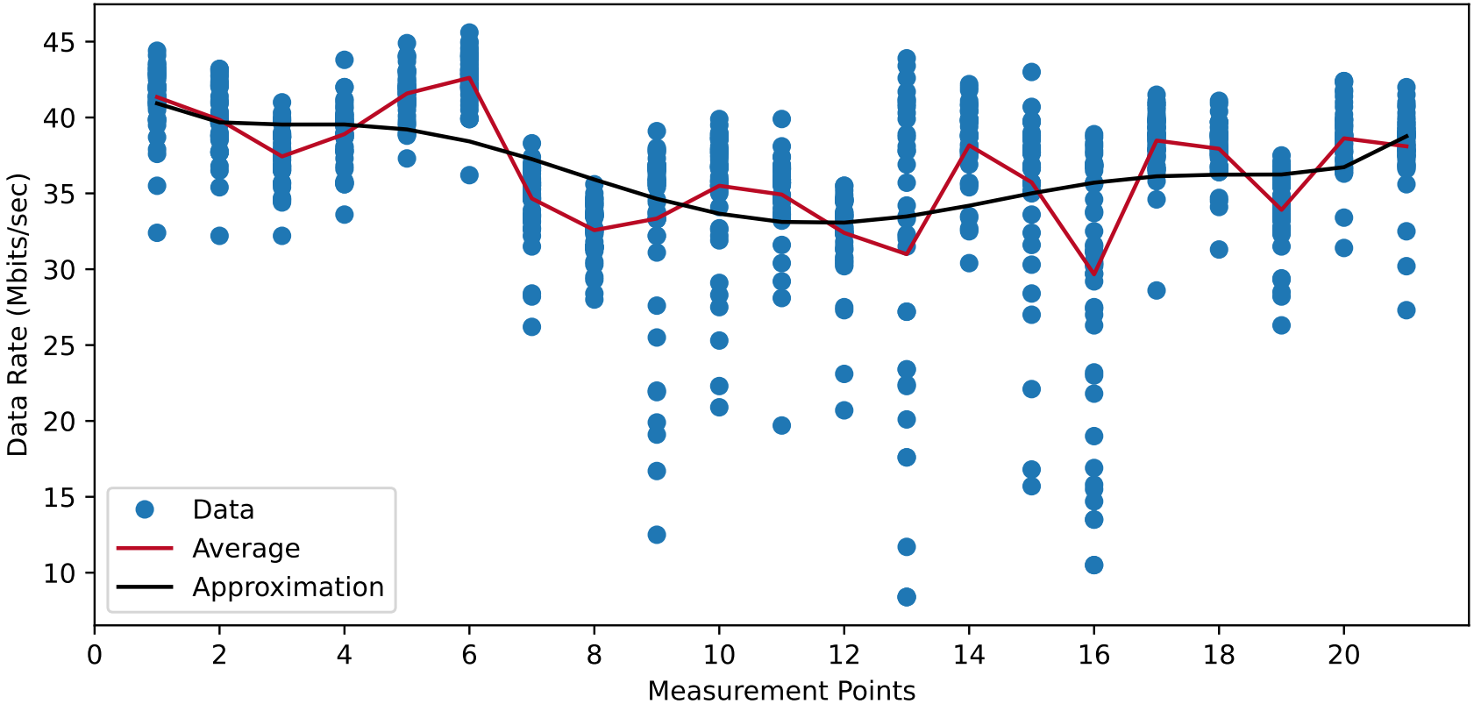
Measurements
Construction Site
Throughput x Measurement points
10.07.2023
© Fraunhofer IPT/WZL der RWTH Aachen
Notes:
Here we have the throughput results. The graph starts around 40 Mbits/sec, and it also shows a similar behavior to the latency charts, since the best throughput results are the highest ones, transferring as much data as possible in a one second interval.
As I said in the firsts slides for this section, after the installation of the omni-antennas, that will allow signal propagation in all directions, and the fiber cables, these results should show a lot of improvement and fit the requirements.

Slide 34
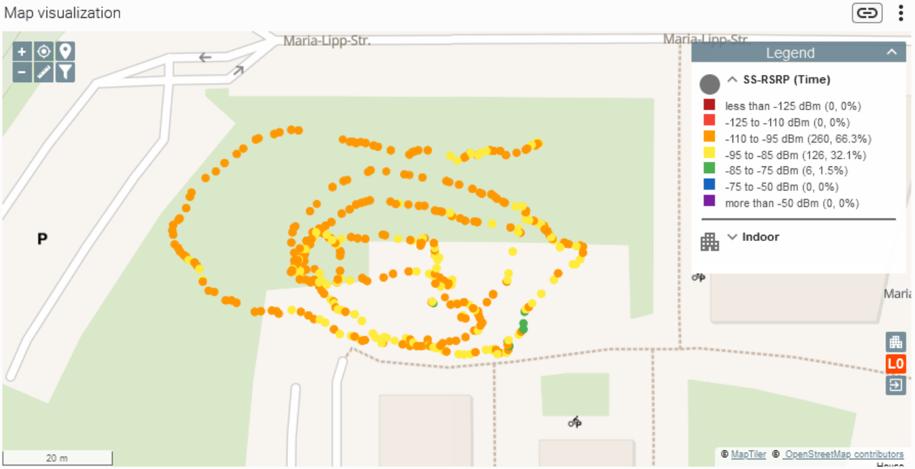
Measurements
Construction Site
Rohde & Schwarz test
Walking test
Around 10 minutes
Signal quality results
Poor network connection
Influence of containers, metals and machinery
10.07.2023
© Fraunhofer IPT/WZL der RWTH Aachen
Notes:
Also for the Construction Site, it was possible for the team to use the Rohde and Scharz ROMES and the SmartAnalytics software to acquire data and analyze them. With those, it was possible to run signal quality measurements so fast that it is almost continuous, I mean without having to define measurement points like we did for the other tests. In the picture we have the walking test performed in a snail shape starting at the edges until it reaches the circumference of the crane. We walked around for 10 minutes, and the results show kind of a poor coverage for the entire area, as we see represented in orange.

Slide 35
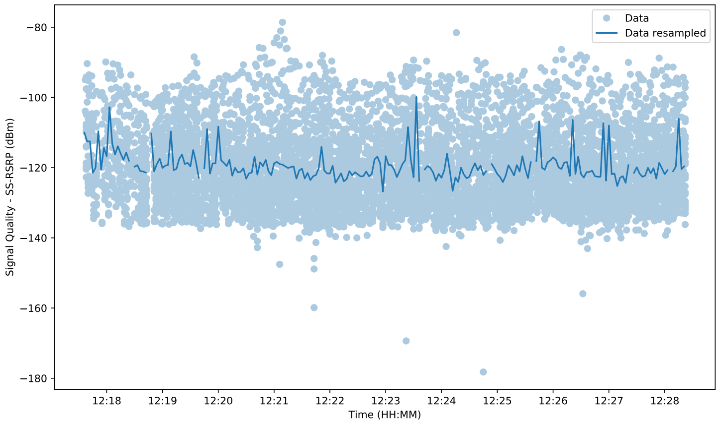
Measurements
Construction Site
Signal Quality x Time
10.07.2023
© Fraunhofer IPT/WZL der RWTH Aachen
Notes:
In this last graph, we have all of the measurement points acquired in the walkining test regarding signal quality. Since there were so many points, we performed a resample of the data. All this resample does is calculate the average value of all the points in a 3 second interval. This was done using the library Pandas, from Python, and it made it possible to smooth the curve, so we were able to actually interpret it.
We already knew about the poor coverage in the area, but now we see that this coverage was basically around the -120 dBm. If we highlight the surroundings

Slide 36
Measurements
Construction Site
Signal Quality x Time
10.07.2023
© Fraunhofer IPT/WZL der RWTH Aachen
Notes:
We can see that most of the results are contained in a range of -120 plus or minus 5 dBm. Just as a remainder, this are temporary results. All of the parameters showed here will be improved when the final setup is done.

Slide 37
Table of Contents
1. | Introduction
2. | Objectives
3. | Contextualization
4. | Measurements Underground Mine Construction Site
5. | Conclusion
10.07.2023
© Fraunhofer IPT/WZL der RWTH Aachen
Notes:
Ok, so we‘re reaching the end, and I would now like to wrap everything up and present the conclusion for this work.

Slide 38
Conclusion
Outcomes and future work
1
The current limitations in the scenarios highlight the need for the new implementations to enable the application of the use cases
2
It was possible to investigate the response of different parameters according to the setups and provide an understanding of the technologies for the continuity of the work
3
In future testing, it is expected that the results will improve as a direct consequence of implementing the new setup in the scenarios
4
It would be interesting to conduct measurements at each stage of the installation process for a better understanding of the impact on the architecture
10.07.2023
© Fraunhofer IPT/WZL der RWTH Aachen
Notes:
[CLICK] First of all, we saw that the current limitations highlighted the need for the new implementations in each scenario, both the Underground Mine and the Construction Site, otherwise the use cases would not fully function.
But despite that, this pre investigation was really important, cause it allowed us to investigate the response of several parameters according to the setups, and also provide understanding for future work.
In that sense, after the setups are complete, it‘s expected - and almost certain - that the results will show improvement and fit the requirements set for the use cases.
Finally, for the next steps, it would be interesting to collect partial information in the stages before the completion of the installation, so we can analyze the impact that each component has on the overall architecture of the project, and how important are they for the final result.

Slide 39

Obrigada · Thank you · Vielen Dank
pela atenção
for your attention
für Ihre Aufmerksamkeit
Notes:
That‘s it for today, everyone! Thank you so much the attention and let me know if you have any questions.

Slide 40
References
—
[1] IPT, F. Anwendungsfeld Bergbau - Lastenheft. Report. Forschungszentrum Jülich. 2021. Internal document.
[2] REICHELT. Industrial LTE Router. 2023. Available at <link>.
[3] AMAZON. BrosTrend AX1800. Available at <link>.
[4] ERICSSON. Ericsson Private 5G System. Available at <link>.
[5] BEDFORD, M. D. et al. Low-cost leaky feeder communication for mines rescue. 2020. Available at <link>.
[6] [a] BROKK. BROKK 170 demolition robot. 2022. Available at <link>.
[b] DOOSAN, E. Hyundai Doosan infracore construction equipment. 2022. Available
at <link>.
[c] MICROSOFT. Flat Icon PowerPoint Library. 2023.
[d] ROBOTICS, U. Innok Robotics INDUROS. 2022. Available at <link>.
[7] EUROPE, G. I. C. OUTDOOR COVERAGE – CAMPUS MELATEN AACHEN. 2023. Available at <link>.
[8] GOOGLE EARTH. Campus Melaten. 2023.
Notes:
Here are the references I used for this slide.

Slide 41
Contact information
—
Luiza Souza Simões
Tel. +49 1575 3510058
Tel. +55 71 981814845
luizassimoes@hotmail.com
Fraunhofer IPT
Steinbachstraße 17
52074 Aachen
www.fraunhofer.de
Notes:
And here is some contact information, if anyone wants to get it touch with me afterwards. Thanks again! ☺

Slide 42
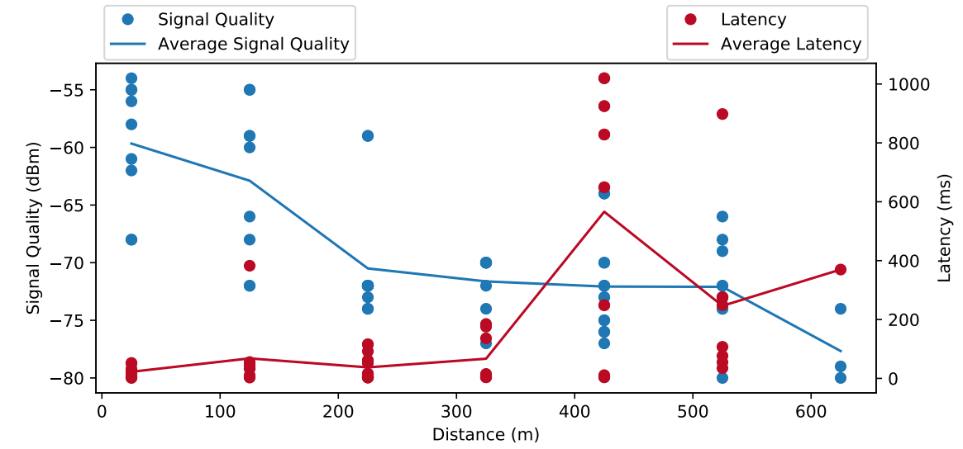
Measurements
Underground Mine
Signal Quality and Latency x Distance for BrosTrend device
10.07.2023
© Fraunhofer IPT/WZL der RWTH Aachen

